Slide 1


Software Quality Engineering

Slide 2
Software Testing

Slide 3
Testing
According to ANSI/IEEE 1059 standard, Testing can be defined as - A process of analyzing a software item to detect the differences between existing and required conditions (that is defects/errors/bugs) and to evaluate the features of the software item.

Slide 4
Who does Testing?
It depends on the process and the associated stakeholders of the project(s). In the IT industry, large companies have a team with responsibilities to evaluate the developed software in context of the given requirements. Moreover, developers also conduct testing which is called Unit Testing. In most cases, the following professionals are involved in testing a system within their respective capacities:
Software Tester
Software Developer
Project Lead/Manager
End User (how…………… ?)
Notes:
User Acceptance Testing (UAT), involves testing the software from a user's perspective or by end users.

Slide 5
When to Start Testing?
Testing is done in different forms at every phase of SDLC:
During the requirement gathering phase, the analysis and verification of requirements are also considered as testing.
Reviewing the design in the design phase with the intent to improve the design is also considered as testing.
Testing performed by a developer on completion of the code is also categorized as testing.
Notes:
An early start to testing reduces the cost and time to rework and produce error-free software that is delivered to the client. However in Software Development Life Cycle (SDLC), testing can be started from the Requirements Gathering phase and continued till the deployment of the software. It also depends on the development model that is being used. For example, in the Waterfall model, formal testing is conducted in the testing phase; but in the incremental model, testing is performed at the end of every increment/iteration and the whole application is tested at the end.

Slide 6
When to Stop Testing?
It is difficult to determine when to stop testing, as testing is a never-ending process and no one can claim that a software is 100% tested. The following aspects are to be considered for stopping the testing process:
Testing Deadlines
Completion of test case execution
Completion of functional and code coverage to a certain point
Bug rate falls below a certain level and no high-priority bugs are identified
Management decision

Slide 7
Functional coverage refers to the extent to which the software has been tested to ensure that it meets its intended functionality or requirements.
Code coverage, on the other hand, refers to the percentage of code that has been tested through automated testing or other methods.
It's important to note that achieving complete functional and code coverage is often difficult or even impossible, particularly for large or complex software projects. Instead, testing efforts typically focus on testing the most critical and high-risk parts of the code, while acknowledging that some areas may remain untested or under-tested.

Slide 8
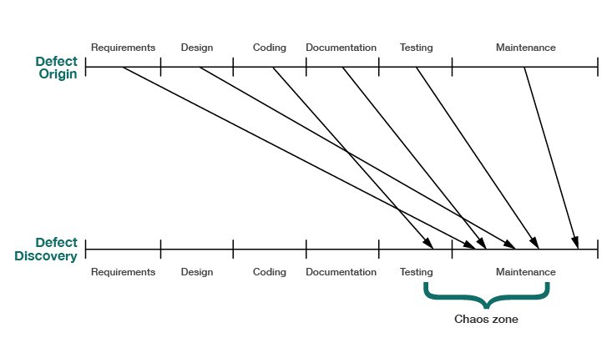

Slide 9
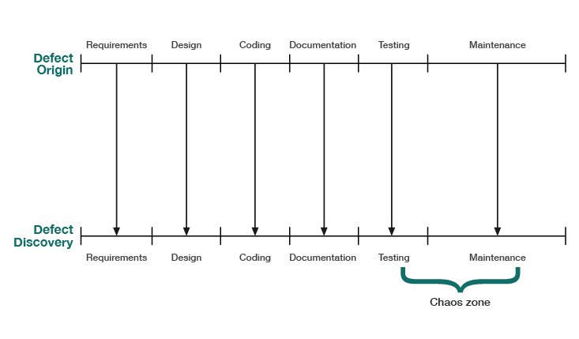

Slide 10
Our objective with Inspections is to reduce the Cost of Quality by finding and removing defects earlier and at a lower cost.

Slide 11
Types of Bugs/Errors | Software Inspection | Software Testing
Checks the complexity of Code | Yes | No
Reviews Code Structure | Yes | No
Identifies interface defects at module level | Yes | No
Checks if new features are to be added | Yes | No
Identifies and resolves boundary level defects | Yes | Yes
Resolve performance errors | Yes | Yes
Checks if any features are implemented incorrectly | Yes | Yes

Slide 12
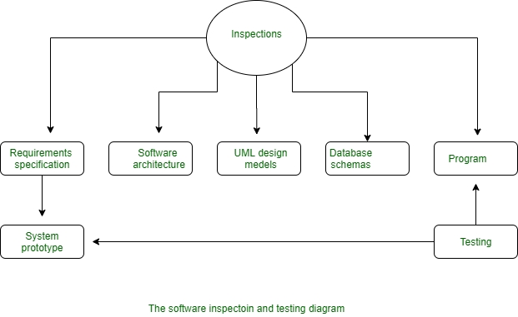

Slide 13
Requirements, architecture, design documents………
Cannot “execute” these as a test

Slide 14
(a reminder)
Verification | Validation
Verification addresses the concern: "Are you building it right?" | Validation addresses the concern: "Are you building the right thing?"
Ensures that the software system meets all the functionality. | Ensures that the functionalities meet the intended behavior.
Verification takes place first and includes the checking for documentation, code, etc. | Validation occurs after verification and mainly involves the checking of the overall product.
Done by developers. | Done by testers.
It has static activities, as it includes collecting reviews, walkthroughs, and inspections to verify a software. | It has dynamic activities, as it includes executing the software against the requirements.

Slide 15
Software Testing - Myths
Myth 1 : Testing is Too Expensive
Reality : There is a saying, pay less for testing during software development or pay more for maintenance or correction later. Early testing saves both time and cost in many aspects, however reducing the cost without testing may result in improper design of a software application rendering the product useless.

Slide 16
Myth 2 : Testing is Time-Consuming
Reality : During the SDLC phases, testing is never a time-consuming process. However diagnosing and fixing the errors identified during proper testing is a time-consuming but productive activity.

Slide 17
Myth 3 : Only Fully Developed Products are Tested
Reality : No doubt, testing depends on the source code but reviewing requirements and developing test cases is independent from the developed code. However iterative or incremental approach as a development life cycle model may reduce the dependency of testing on the fully developed software.

Slide 18
Myth 4 : Complete Testing is Possible
Reality : It becomes an issue when a client or tester thinks that complete testing is possible. It is possible that all paths have been tested by the team but occurrence of complete testing is never possible. There might be some scenarios that are never executed by the test team or the client during the software development life cycle and may be executed once the project has been deployed.

Slide 19
Myth 5 : A Tested Software is Bug-Free
Reality : This is a very common myth that the clients, project managers, and the management team believes in. No one can claim with absolute certainty that a software application is 100% bug-free even if a tester with superb testing skills has tested the application.

Slide 20
Myth 6 : Missed Defects are due to Testers
Reality : It is not a correct approach to blame testers for bugs that remain in the application even after testing has been performed. This myth relates to Time, Cost, and Requirements changing Constraints. However the test strategy may also result in bugs being missed by the testing team.

Slide 21
Myth 7 : Testers are Responsible for Quality of Product
Reality : It is a very common misinterpretation that only testers or the testing team should be responsible for product quality. Testers’ responsibilities include the identification of bugs to the stakeholders and then it is their decision whether they will fix the bug or release the software. Releasing the software at the time puts more pressure on the testers, as they will be blamed for any error.

Slide 22
Myth 8 : Test Automation should be used wherever possible to Reduce Time
Reality : Yes, it is true that Test Automation reduces the testing time, but it is not possible to start test automation at any time during software development. Test automaton should be started when the software has been manually tested and is stable to some extent. Moreover, test automation can never be used if requirements keep changing.

Slide 23
Myth 9 : Anyone can Test a Software Application
Reality : People outside the IT industry think and even believe that anyone can test a software and testing is not a creative job. However testers know very well that this is a myth. Thinking alternative scenarios, try to crash a software with the intent to explore potential bugs is not possible for the person who developed it.

Slide 24
Myth 10 : A Tester's only Task is to Find Bugs
Reality : Finding bugs in a software is the task of the testers, but at the same time, they are domain experts of the particular software. Developers are only responsible for the specific component or area that is assigned to them but testers understand the overall workings of the software, what the dependencies are, and the impacts of one module on another module.

Slide 25
QA vs QC vs Testing
QA , QC already discussed in lecture 1.
QC vs Testing ?
They can be considered as same activities, but there exist distinguishing points that set them apart.
QC | Testing
It is a corrective process. | It is a preventive process.
QC can be considered as the subset of Quality Assurance. | Testing is the subset of Quality Control.

Slide 26
Standard | Description
IEEE 829 | A standard for the format of documents used in different stages of software testing.
IEEE 1061 | A methodology for establishing quality requirements, identifying, implementing, analyzing, and validating the process, and product of software quality metrics.
IEEE 1059 | Guide for Software Verification and Validation Plans.
IEEE 1008 | A standard for unit testing.
IEEE 1012 | A standard for Software Verification and Validation.
IEEE 1028 | A standard for software inspections.
IEEE 1044 | A standard for the classification of software anomalies.
IEEE 1044-1 | A guide for the classification of software anomalies.
IEEE 830 | A guide for developing system requirements specifications.
IEEE 730 | A standard for software quality assurance plans.
IEEE 1061 | A standard for software quality metrics and methodology.
IEEE 12207 | A standard for software life cycle processes and life cycle data.
BS 7925-1 | A vocabulary of terms used in software testing.
BS 7925-2 | A standard for software component testing.

Slide 27
Much more formal and controlled are the two definitions for testing suggested by IEEE Std 610.12 (IEEE, 1990): “(1) The process of operating a system or component under specified conditions, observing or recording the results, and making an evaluation of some aspect of the system or component. (2) The process of analyzing a software item to detect the differences between existing and required conditions (that is, bugs) and to evaluate the features of the software item.”

Slide 28
Software tests – definition Software testing is a formal process carried out by a specialized testing team in which a software unit, several integrated software units or an entire software package are examined by running the programs on a computer. All the associated tests are performed according to approved test procedures on approved test cases.

Slide 29
Formal
– Software test plans are part of the project’s development and quality plans, scheduled in advance and often a central item in the development agreement signed between the customer and the developer. In other words, ad hoc examination of software by a colleague or regular checks by the programming team leader cannot be considered software tests

Slide 30
Specialized testing team
– An independent team or external consultants who specialize in testing are assigned to perform these tasks mainly in order to eliminate bias and to guarantee effective testing by trained professionals. In addition, it is generally accepted that tests performed by the developers themselves will yield poor results, as those individuals who developed the original product will find it difficult to reveal errors that they were unable to identify earlier. Still, unit tests continue to be performed by developers in many organizations.

Slide 31
Running the programs
– Any form of quality assurance activity that does not involve running the software, for example code inspection, cannot be considered as a test

Slide 32
Approved test procedures
– The testing process performed according to a test plan and testing procedures that have been approved as conforming to the SQA procedures adopted by the developing organization.

Slide 33
Approved test cases
– The test cases to be examined are defined in full by the test plan. No omissions or additions are expected to occur during testing. In other words, once the process has begun, the tester is not allowed to exercise discretion by omitting a test case he or she considers redundant or by adding a new test case, promising though it may be.

Slide 34
Software testing objectives

Slide 35
Direct objectives
■ To identify and reveal as many errors as possible in the tested software.
■ To bring the tested software, after correction of the identified errors and
retesting, to an acceptable level of quality.
■ To perform the required tests efficiently and effectively, within budgetary
and scheduling limitations.

Slide 36
Indirect objective
■ To compile a record of software errors for use in error prevention (by corrective and preventive actions)

Slide 37
Software testing strategies (basic level)
■ To test the software in its entirety, once the completed package is available; otherwise known as “big bang testing”.
■ To test the software piecemeal, in modules, as they are completed (unit tests); then to test groups of tested modules integrated with newly completed modules (integration tests). This process continues until all the package modules have been tested. Once this phase is completed, the entire package is tested as a whole (system test). This testing strategy is usually termed “incremental testing”

Slide 38
Bottom-up and top-down
Incremental testing is also performed according to two basic strategies: bottom-up and top-down. Both incremental testing strategies assume that the software package is constructed of a hierarchy of software modules.
In top-down testing, the first module tested is the main module, the highest level module in the software structure; the last modules to be tested are the lowest level modules.
In bottom-up testing, the order of testing is reversed: the lowest level modules are tested first, with the main module tested last.

Slide 39
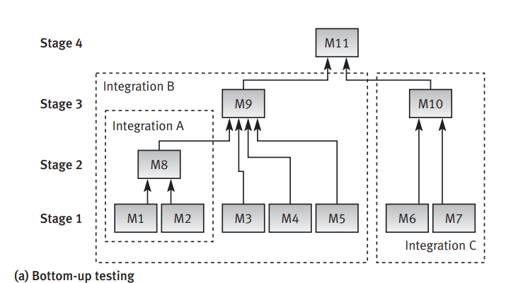

Slide 40
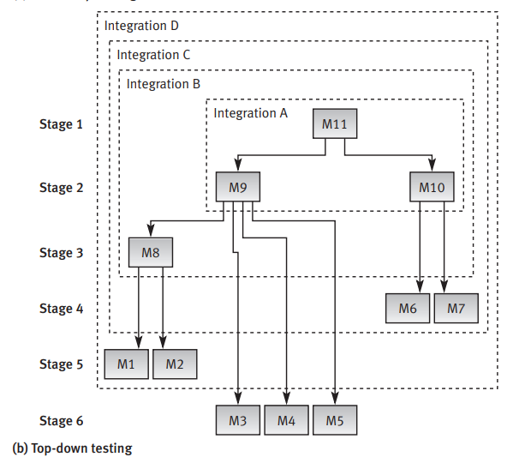

Slide 41
Another way to classify
Breadth first testing: This testing strategy involves testing all the features of a system at a high level, then going back and testing each feature in more detail. This means that all the features of the system are tested at a similar level of depth before moving on to the next feature.
The main advantage of this approach is that it ensures that all the features of the system are tested, and any major issues are caught early on.

Slide 42
Depth first testing: In this approach, one feature or component of the system is tested in detail before moving on to the next one. This means that the tester spends more time testing a particular feature or component, and moves on to the next one only after they are satisfied that the current feature is working as expected.
The main advantage of this approach is that it allows the tester to focus on the details of each feature, and uncover any subtle issues that might be missed in a higher-level test.

Slide 43
Stub and Driver (in incremental testing)
stub (often termed a “dummy module”) replaces an unavailable lower level module, subordinate to the module tested. Stubs are required for topdown testing of incomplete systems.
Like a stub, a driver is a substitute module but of the upper level module that activates the module tested. The driver is passing the test data on to the tested module and accepting the results calculated by it. Drivers are required in bottom-up testing until the upper level modules are developed (coded).

Slide 44
Stubs | Drivers
Stubs are used in Top-Down Integration Testing. | Drivers are used in Bottom-Up Integration Testing.
Stubs are basically known as a “called programs” and are used in the Top-down integration testing. | While, drivers are the “calling program” and are used in bottom-up integration testing.
Stubs are similar to the modules of the software, that are under development process. | While drivers are used to invoking the component that needs to be tested.
Stubs are basically used in the unavailability of low-level modules. | While drivers are mainly used in place of high-level modules and in some situation as well as for low-level modules.
Stubs are taken into use to test the feature and functionality of the modules. | Whereas the drivers are used if the main module of the software isn’t developed for testing.
The stubs are taken into concern if testing of upper-levels of the modules are done and the lower-levels of the modules are under developing process. | The drivers are taken into concern if testing of lower-levels of the modules are done and the upper-levels of the modules are under developing process.
Stubs are used when lower-level of modules are missing or in a partially developed phase, and we want to test the main module. | Drivers are used when higher-level of modules are missing or in a partially developed phase, and we want to test the lower(sub)- module.

Slide 45
Example of stub and driver
For example

Slide 46
Tell me in next class
Fake vs mock vs stub ?

Slide 47
Bottom-up versus top-down strategies
The main advantage of the bottom-up strategy is the relative ease of its performance, whereas the main disadvantage is the lateness at which the program as a whole can be observed (that is, at the stage following testing of the last module).
The main advantage of the top-down strategy is the possibilities it offers to demonstrate the entire program functions shortly after activation of the upper-level modules has been completed. In many cases, this characteristic allows for early identification of analysis and design errors related to algorithms, functional requirements, and the like.

Slide 48
The main disadvantage of this strategy is the relative difficulty of preparing the required stubs, which often require very complicated programming.
Another disadvantage is the relative difficulty of analyzing the results of the tests.
Testing experts continue to debate over which strategy is preferable – bottom-up or top-down. While the positions taken vary, it seems that the strategy chosen is actually determined in most cases by the developers’ choice of development – not test – strategy, that is, bottom-up or top-down.

Slide 49
Clearly, testers should follow the developers’ approach because it is crucial that testing will be performed immediately after a module has been coded.
Implementation of a testing strategy that differs from the development strategy will cause substantial delays in scheduling of the tests.

Slide 50
Classification according to testing concept
■ Black box (functionality) testing. Identifies bugs only according to software malfunctioning as they are revealed in its erroneous outputs. In cases that the outputs are found to be correct, black box testing disregards the internal path of calculations and processing performed.
■ White box (structural) testing. Examines internal calculation paths in order to identify bugs. Although the term “white” is meant to emphasize the contrast between this method and black box testing, the method’s other name – “glass box testing” – better expresses its basic characteristic, that of investigating the correctness of code structure

Slide 51
Classification according to requirements
McCall’s classic model for classification of software quality requirements. His model has been extended here to the classification of the tests carried out to ensure full coverage of the respective requirements.
The requirements and their corresponding tests are shown in Table

Slide 52
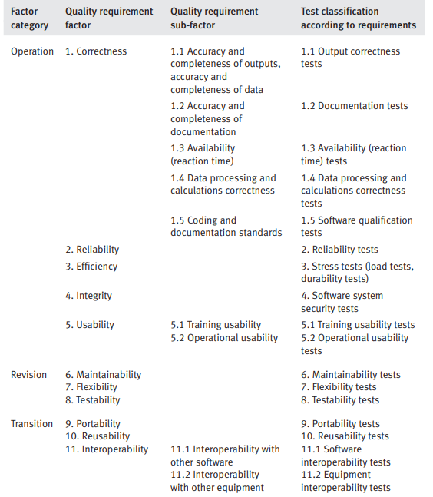

Slide 54
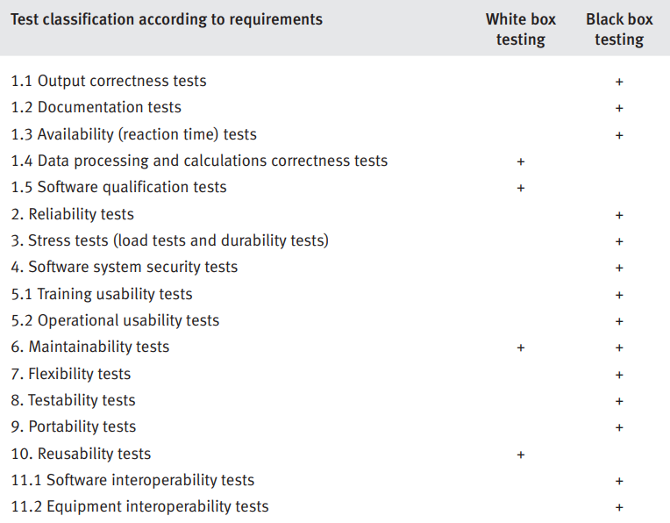
Notes:
Turning to software qualification, the focus here shifts to the examination of software code (including comments) compliance with coding standards and work instructions.

Slide 55
A Strategy for Testing Software
System Testing
Narrow to
Broader scope
Validation Testing
Integration Testing
Unit Testing
Code
Abstract to
concrete
Design
Requirements
System Engineering

Slide 56
Testing Principles
1. All tests should be traceable to customer requirements
  The objective of software testing is to find defects. It follows that the most severe defects are those that cause systems to fail to meet their requirements
2. Tests should be planned long before testing begins.
  Test planning can begin as soon as the requirements model is complete
3. The Pareto (80-20) principle applies to software testing
  80% of all defects found will likely be traced to 20% of modules. These error-prone modules should be isolated and tested thoroughly.

Slide 57
Testing Principles
4. The testing should begin “in the small” and progress toward testing “in the large”.
  The first tests planned and executed focus on individual components. As testing progresses, focus shifts to integrated clusters of components.
5. Exhaustive testing is not possible.
  It is impossible to execute every combination of paths during testing. It is possible, however, to adequately cover program logic and to ensure that all conditions in the component-level design have been exercised.

Slide 58
Types of software Testing

Slide 59
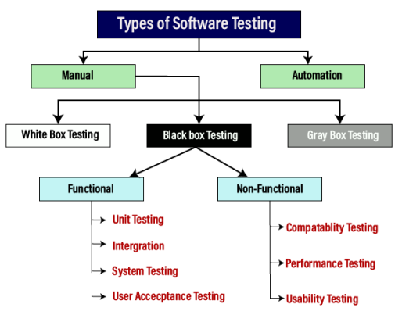
Manual vs Automation
In manual testing (as the name suggests), test cases are executed manually (by a human, that is) without any support from tools or scripts.
But with automated testing, test cases are executed with the assistance of tools, scripts, and software.

Slide 60
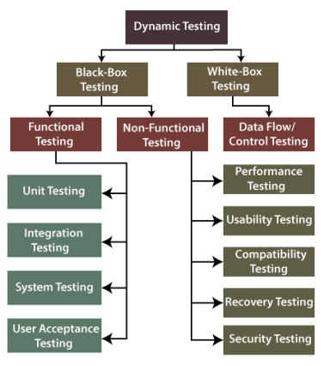
Static vs Dynamic
Static Testing is a type of software testing in which software application is tested without code execution. Manual reviews of code, requirement documents and document design are done in order to find the errors.
The main objective of static testing is to improve the quality of software applications by finding errors in early stages of software development process.

Slide 61
Static Testing
To avoid the errors, we will execute Static testing in the initial stage of development because it is easier to identify the sources of errors, and it can fix easily.
We can do some of the following important activities while performing static testing:
  Business requirement review (functional requirement, Use case reviews)
  Design review (architecture + design) (non-functional requirements)
  The test documentation review

Slide 62
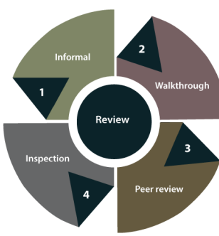
Static Testing
In static testing, reviews can be divided into four different parts, which are as follows:
Informal reviews
In informal review, the document designer place the contents in front of viewers, and everyone gives their view; therefore, bugs are acknowledged in the early stage.
Walkthrough
Generally, the walkthrough review is used to performed by a skilled person or expert to verify the bugs. Therefore, there might not be problem in the development or testing phase.

Slide 63
Static Testing
Peer review
In Peer review, we can check one another's documents to find and resolve the bugs, which is generally done in a team.
Inspection
In review, the inspection is essentially verifying the document by the higher authority, for example, the verification of SRS [software requirement specifications] document.

Slide 64
Black box Testing

Slide 65
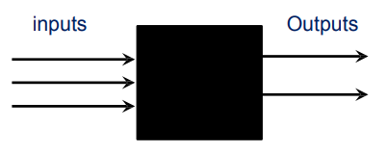
Black Box Testing
A strategy in which testing is based on requirements and specifications.
In this method, tester selects a function and gives input value to examine its functionality, and checks whether the function is giving expected output or not. If the function produces correct output, then it is passed in testing, otherwise failed.
No knowledge of internal design or code required.
Tests are data driven.

Slide 66
Black box Testing techniques

Slide 67
Black Box Testing Techniques
Exhaustive testing
Equivalence class testing (Equivalence Partitioning)
Boundary value analysis
Decision table testing
State-Transition testing

Slide 68
1. Exhaustive testing
Definition: testing with every member of the input value space
Input value space: the set of all possible input values to the program
  Consider an application in which a password field that accepts 3 characters, with no consecutive repeating entries. Hence, there are 26 * 26 * 26 input permutations for alphabets only. Including special characters and standard characters, there are much more combinations. So, there are 256 * 256 * 256 input combinations.
Notes:
A simple example of exhaustive testing could be testing a simple calculator application that performs addition and subtraction operations on two numbers. To exhaustively test this calculator application, we would need to test all possible combinations of two numbers and two operations (addition and subtraction).
For example, if we limit our inputs to positive integers from 1 to 3, the possible combinations are:
1 + 1
1 - 1
1 + 2
1 - 2
1 + 3
1 - 3
2 + 1
2 - 1
2 + 2
2 - 2
2 + 3
2 - 3
3 + 1
3 - 1
3 + 2
3 - 2
3 + 3
3 - 3
In this case, we would need to test all 18 possible combinations to ensure that the calculator application performs as expected for all possible inputs. This is an example of exhaustive testing because we are testing all possible combinations of inputs. However, exhaustive testing may not be practical for more complex systems with a large number of inputs or states.

Slide 69
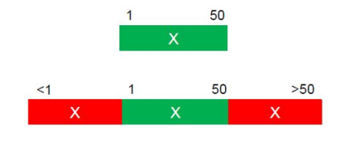
2. Equivalence Class Testing/ Portioning
Equivalence Class Testing is when you have a number of test items (e.g. values) that you want to test but because of cost (time/money) you do not have time to test them all.
Therefore you group the test item into class where all items in each class are suppose to behave exactly the same.
The theory is that you only need to test one of each item to make sure the system works.
Notes:
For example, consider a system that accepts a numeric input in the range of 1 to 100. Equivalence Class Testing would involve dividing the range of input values into equivalence classes that exhibit similar behavior, such as:
Inputs less than 1
Inputs between 1 and 100
Inputs greater than 100
Test cases would then be selected from each equivalence class to ensure that the system behaves correctly for all possible inputs within each class.
Equivalence Class Testing can be applied to various types of inputs, such as input fields, menus, and buttons, and can help to ensure that the system under test is thoroughly tested while reducing the number of test cases required.

Slide 70
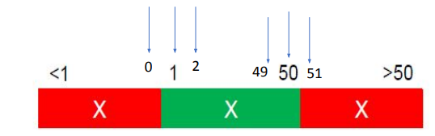
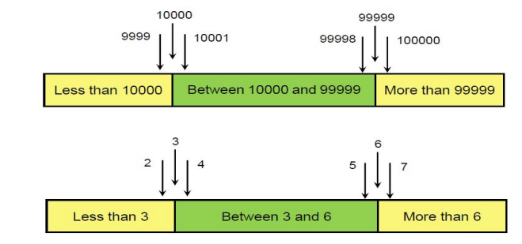
3. Boundary Value Analysis
Maximum Defects occurs on Boundaries
1.Identify the Equivalence Classes and Identify the boundaries of each Equivalence Class.
2.Create test cases for each boundary value by choosing one point on the boundary, one point just below the boundary, and one point just above the boundary.
Notes:
Min val
Min-1
Min-max
Max+1

Slide 71
Why to go with Boundary Value Analysis?
Consider an example where a developer writes code for an amount text field which will accept and transfer values only from 100 to 5000.
The test engineer checks it by entering 99 into the amount text field and then clicks on the transfer button. It will show an error message as 99 is an invalid test case, because the boundary values are already set as 100 and 5000.
Since 99 is less than 100, the text field will not transfer the amount.

Slide 72
4. Decision Table Testing
An tool for capturing certain kinds of system requirements and documenting internal system design.
Record complex business rules that a system must implement.
Also can serve as a guide to creating test cases.

Slide 73
4. Decision Table Testing
Condition
▪ Condition describe the conditions or factors that will affect the decision or policy.
▪ They are listed in the upper section of the decision table.
Action
▪ Action describe, in the form of statements, the possible policy actions or decisions
▪ They are listed in the lower section of the decision table.
Rules
▪ Rules describe which actions are to be taken under a specific combination of conditions.

Slide 74
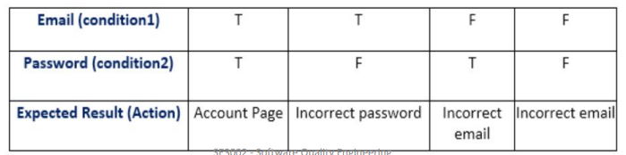
4. Decision Table Testing
Most of us use an email account, and when you want to use an email account, for this you need to enter the email and its associated password.
If both email and password are correctly matched, the user will be directed to the email account's homepage; otherwise, it will come back to the login page with an error message specified with "Incorrect Email" or "Incorrect Password."

Slide 75
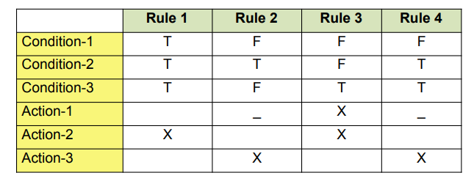
4. Decision Table

Slide 76
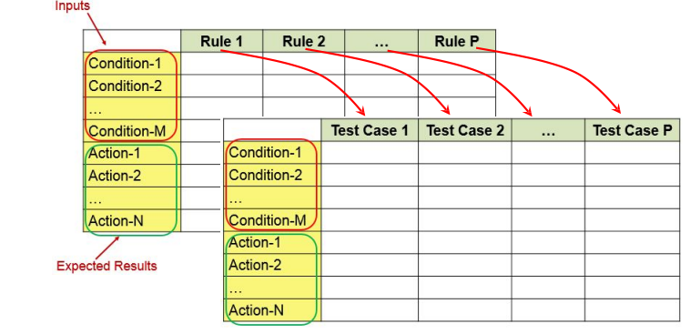
Decision Table Vs Test Case Table
A decision table converted to a test case.
Notes:
A decision table is a tool used for test design, which helps to capture and organize the logic of a system under test. It is a structured way to represent complex business rules or logical conditions that affect the behavior of the system. A decision table typically consists of columns representing conditions, actions, and rules, and rows representing possible combinations of conditions and actions.
A test case, on the other hand, is a set of specific inputs, preconditions, and expected outputs that are designed to test a specific aspect of the system under test. Test cases are used to validate whether a system behaves as expected under certain conditions, and they are typically documented in a test case specification.
While decision tables and test cases are different, they are related in the sense that a decision table can be used to derive test cases.

Slide 77
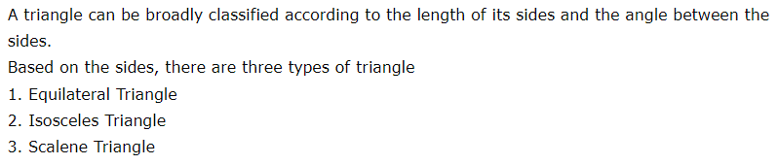
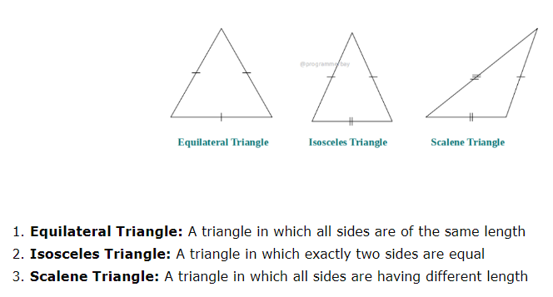

Slide 78
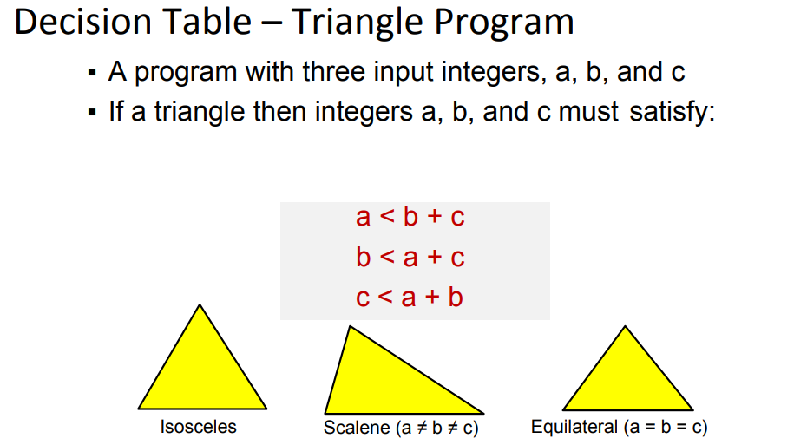

Slide 79
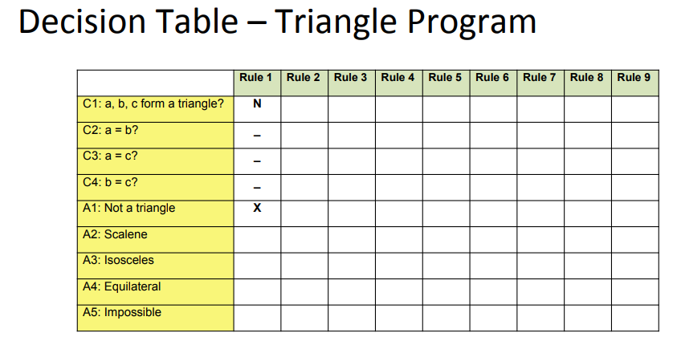

Slide 80
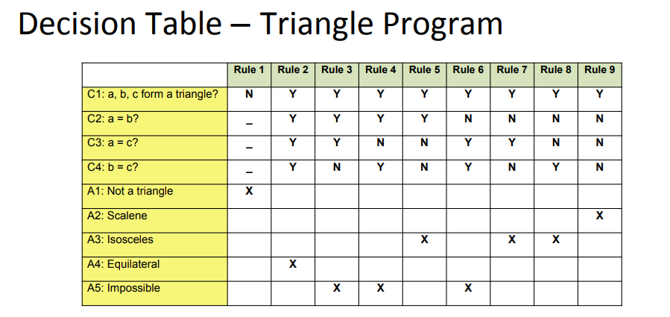

Slide 81
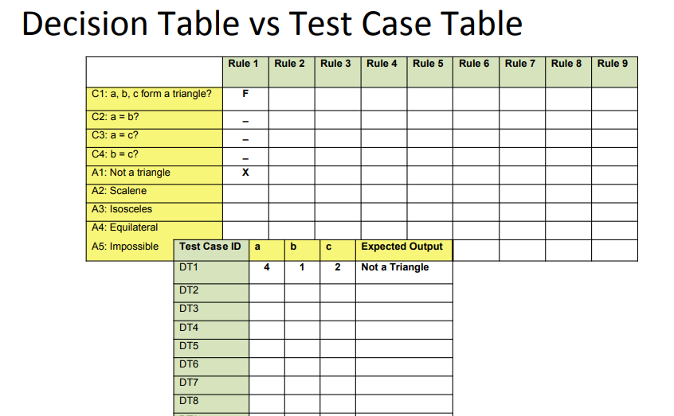

Slide 82
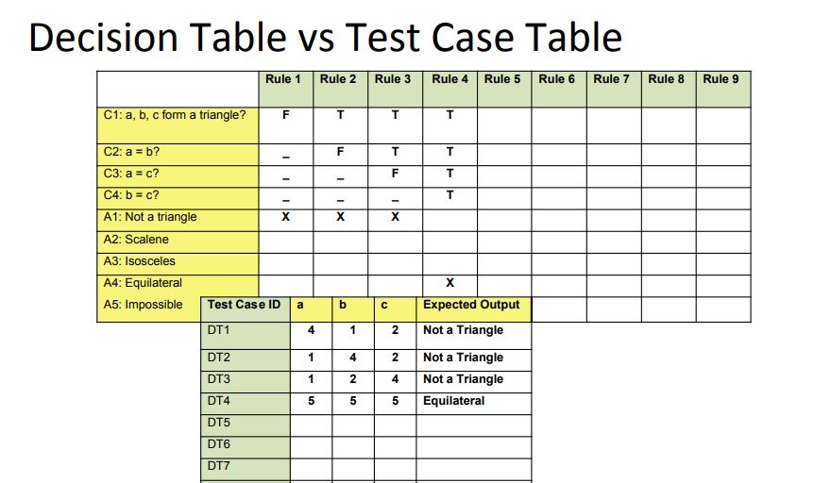

Slide 83
Applicability
Decision table testing can be used whenever the system must implement complex business rules when these rules can be represented as a combination of conditions and when these conditions have discrete actions associated with them.

Slide 84
5. State Transition Testing
State Transition Testing is a black box testing technique in which changes made in input conditions cause state changes or output changes in the Application under Test.
State transition testing helps to analyze behavior of an application for different input conditions.
Testers can provide positive and negative input test values and record the system behavior.

Slide 85
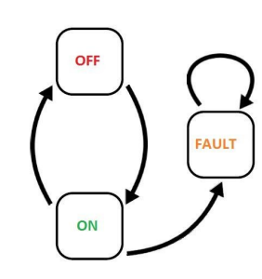
5. State Transition Testing
Models each state a system can exist in
▪ Models each state transition
▪ States
  ‒ Start State
  ‒ Input
  ‒ Output
  ‒ Finish State

Slide 86

5. State Transition Testing
State ‒
Represented by a circle or oval shape.
A state is a condition in which a system is waiting for one or more events.
States "remember" inputs the system has received in the past and define how the system should respond to subsequent events when they occur.
These events may cause state-transitions and/or initiate actions.

Slide 87
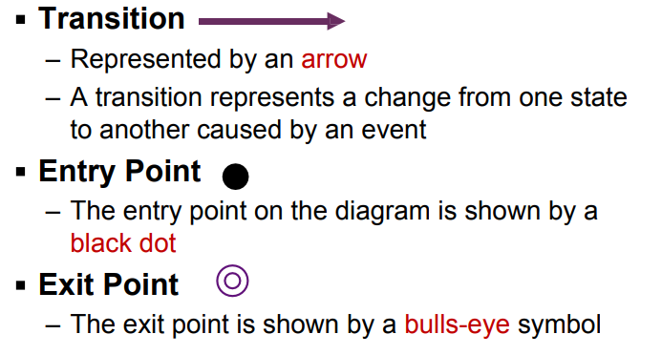
5. State Transition Testing

Slide 88
5. State Transition Testing
Action
An action is an operation initiated because of a state change.
Often these actions cause something to be created that are outputs of the system.
Actions occur on transitions between states

Slide 89
states | Event 1 | Event 2 | …Event n

Slide 90
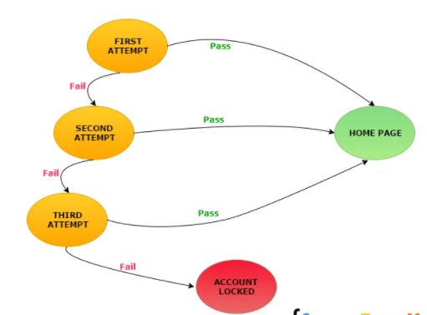
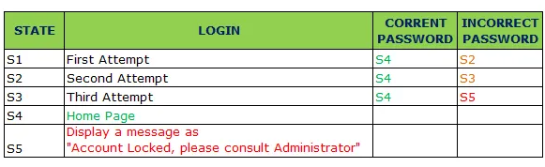

Slide 91


